Slide 1
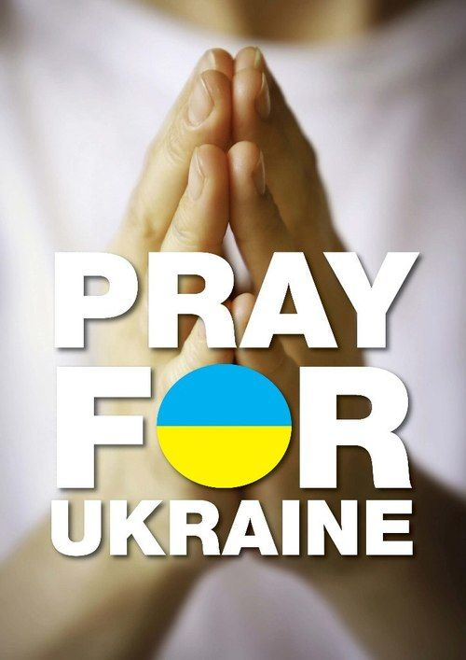
Prayers for peace in Ukraine

Slide 2
Today we pray for the people of Ukraine who would suffer most if current tensions escalate to an invasion or war. While diplomacy continues between major powers, we remember those who stand to lose the most from conflict. God, we pray for your peace to reign. Help all involved to maintain peace in the situation. Amen
From the Joint Public Issues Team

Slide 3
We pray to you, God all loving,
for the gift of peace in our world.
At this time of rising tension and insecurity,
we pray for our sisters and brothers in Ukraine.
We pray to you, God all loving,
seeking lasting and peaceful solutions.
Inspire the people of Ukraine
and the peoples of its neighbouring countries
in their search for peace.
You created the human family to live as brothers and sisters.
As a family created by you, God all loving,
we pray for peace.
Amen
Fr Gerry Hefferan, Australia

Slide 4
The news can be difficult to listen to and to read.
When that news relates to faces we know and to voices familiar to us,
It becomes all the harder to hear.
Lord God, We ask you to hold the people of Ukraine deep in your heart.
Protect them, we pray; from violence, from political gamesmanship,
from being used and abused.
Give, we pray, the nations of the world the courage and the wisdom
to stand up for justice
and the courage too, to dare to care - generously.

Slide 5
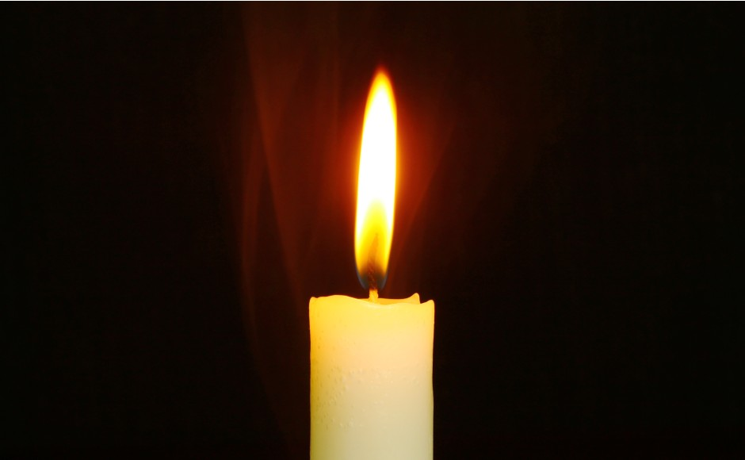
Lord in your mercy, take from us all,
The tendencies in us that seek to lord it over others:
Take from us those traits that see us pursuing our own needs and wants before those of others.
Teach us how to live in love and dignity
And respect - following your example.
In your name and for your sake,
Amen
The Church of Scotland

Slide 6
Oh where shall peace be found?
O where shall peace be found,
and where an end to slaughter,
all lands be holy ground,
all peoples free from murder?
Where weapons are unmade
the prophet’s word comes true,
and none shall be afraid
when God makes all things new.

Slide 7
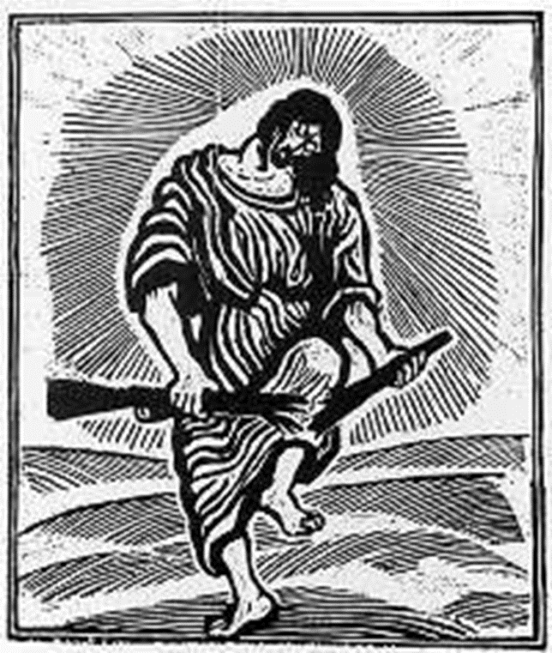
The mountain of the Lord
shall rise above all others;
in Christ we are restored
as neighbours, sisters, brothers:
our grey machines of death
are turned to nobler use
when over all the earth
his kingdom is let loose.

Slide 8
We long to see the day
when love completes that vision,
but God who hears us pray
demands our clear decision:
Lord, give us ears to hear,
and wills to heed, your voice;
to yield no more to fear,
to make your path our choice.
Christopher Idle

Slide 9
We pray for those who work for peace in countries where such work is difficult. Countries in which freedom of speech and freedom to campaign do not exist in the same way as in our own. That somehow You will find ways for those silenced voices to be heard.
We pray for Your Church in Ukraine and Russia and the surrounding countries. Orthodox, Catholic and all other denominations. Help them all to witness to the peace of the gospel to those around them and those in power.

Slide 10
We pray that you will give strength to Christians in the different countries to help them see that their first allegiance is to You and that they will do what they can to reject calls for violence towards their fellow human beings and fellow Christians.
We pray that You will give wisdom to all political leaders particularly in Ukraine and Russia, the wisdom to see first and foremost that war and the horrors that it brings is not the way to settle disputes. We pray that they will be able to forgive the events in the past that lead to tensions between nations now and work to achieve a peaceful world today.

Slide 11
Icon in the Ukrainian tradition by Inna Tuch

Slide 12
May my prayer go
To you like the aroma of incense
And the heart drawn without ceasing
Into your glorious heavenly temple
God, I pray for Ukraine
God, I pray for its people
May you forgive them
May you save them
And show us your mercy

Slide 13
God, I know you are going to be with us
In your temple under the heavens
You gifted us with your joy and peace
You gave your life for the people
You inscribed us in the Book of Life
In your Living Word
You laid out the vision for life
So that all the people would pray to God
To the one who died for them on the cross.
St. Mary’s Parish, Winnipeg, Canada

Slide 14
FOR THE HEALING OF THE NATIONS
For the healing of the nations,
Lord, we pray with one accord;
for a just and equal sharing
of the things that earth affords.
To a life of love in action
help us rise and pledge our word.

Slide 15
Lead your people into freedom,
from despair your world release,
that, redeemed from war and hatred,
all may come and go in peace.
Show us how, through care and goodness,
fear will die and hope increase.

Slide 16
All that kills abundant living,
let it from the earth be banned:
pride of status, race or schooling,
dogmas that obscure your plan.
In our common quest for justice
may we hallow life's brief span.

Slide 17
You, Creator-God, have written
your great name on humankind;
for our growing in your likeness,
bring the life of Christ to mind;
that by our response and service
earth its destiny may find.
Fred Kaan

Slide 19
The Coventry Litany of Reconciliation
All have sinned and fallen short of the glory of God.
The hatred which divides nation from nation, race from race, class from class,
FATHER FORGIVE
The covetous desires of people and nations to possess what is not their own,
FATHER FORGIVE
The greed which exploits the work of human hands and lays waste the earth,
FATHER FORGIVE
Our envy of the welfare and happiness of others,
FATHER FORGIVE

Slide 20
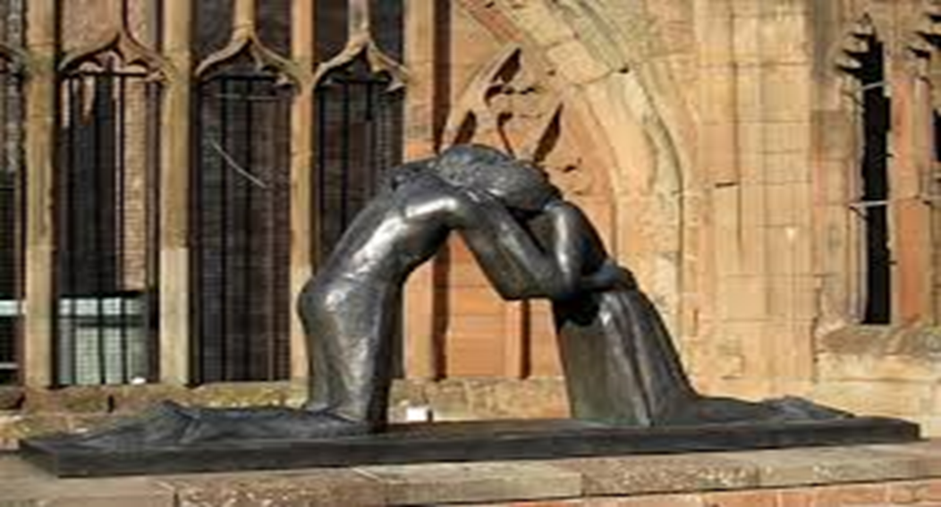
Our indifference to the plight of the imprisoned, the homeless, the refugee,
FATHER FORGIVE
The lust which dishonours the bodies of men, women and children,
FATHER FORGIVE
The pride which leads us to trust in ourselves and not in God,
FATHER FORGIVE
Be kind to one another, tender hearted, forgiving one another, as God in Christ forgave you.

Slide 21
O God,
Lead us from death to life, from falsehood to truth.
Lead us from despair to hope, from fear to trust.
Lead us from hate to love, from war to peace.
Let peace fill our hearts, our world, our universe.
AMEN

